Slide 1
Ecommerce System
Database Management System
LAB
Guided by
Prof.Y.A.Handge
Team members:-
1. Jaypal Kawale (31436) 2. Mohit Mandlecha (31446) 3. Rajat Minekar (31448) 4.Pritesh Nikale (31451)

Slide 2
Contents in the presentation
1.Abstract
2.Introduction
3.Implementation
4.Screenshots
5.Conclusion and future scope

Slide 3
Abstract
Electronic Commerce is exactly analogous to a marketplace on the Internet.Electronic Commerce (also referred to as EC, e-commerce eCommerce orecommerce) consists primarily of the distributing, buying, selling, marketing and servicing of products or services over electronic systems such as the Internet and other computer networks. E-commerce follows the same basic principles that traditional commerce follows-that is, buyers and sellers exchange and transport goods from one place to another. But rather than conducting business in the traditional way in stores and other "brick and mortar" buildings or through mail order catalogs and telephone operators-in e-commerce buyers and sellers transact business over networked Computers.
At the close of the 20th century, retail transactions made up the largest part of e-commerce. Consumers purchased computers, airline tickets, hotelrooms, automobiles, clothing, electronics, books, event tickets, food,furniture, and countless other commodities over the Internet. Business-tobusiness commerce represented one of the fastest growing segments of e-commerce. Businesses ordered supplies and coordinated complicatedprojects electronically.

Slide 4
Introduction
Electronic Commerce is exactly analogous to a marketplace on the Internet.Electronic Commerce (also referred to as EC, e-commerce) consists primarily of the distributing, buying, selling, marketing and servicing of products or services over electronic systems such as the Internet and other computer networks. E-commerce follows the same basic principles that traditional commerce follows-that is, buyers and sellers exchange and transport goods from one place to another. But rather than conducting business in the traditional way in stores and other "brick and mortar" buildings or through mail order catalogs and telephone operators-in e-commerce buyers and sellers transact business over networked Computers.
At the close of the 20th century, retail transactions made up the largest part of e-commerce. Consumers purchased computers, airline tickets, hotel rooms, automobiles, clothing, electronics, books, event tickets, food,furniture, and countless other commodities over the Internet. Business-to-business commerce represented one of the fastest growing segments of e-commerce. Businesses ordered supplies and coordinated complicated projects electronically.

Slide 5
Requirement Analysis
Hardware required for the project
Computer with Intel i5 and above processor.
Software required for the project
Ubuntu OS or Windows
MySql
Java Swing.

Slide 6
Problem Statement
An e-commerce web app built in Java, Swing which highlights various SQL queries to extract data from a large database.
Functionalities:-
Adding suppliers
Registering customers
Deleting customers
Deleting suppliers
Finding all the products supplied by specific supplier
Viewing the products ordered on a particular date by a particular supplier

Slide 7
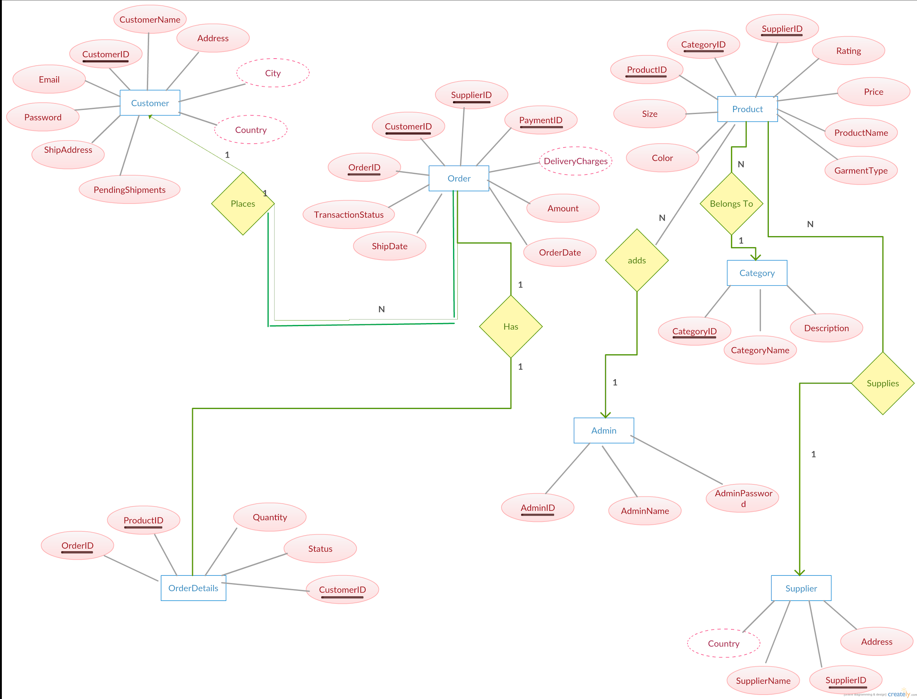
ER diagram

Slide 8
Implementation
Firstly we need to register as a customer in the Ecommerce system
After registering we login into the system and can check the various functionalities provided by the system
If we need to work as a supplier then provide detail to the admin ,admin will add you as the supplier and add your products
Admin have various functionalities like ad supplier,delete supplier, add customer, delete customer, search at particular date how many products been ordered

Slide 9
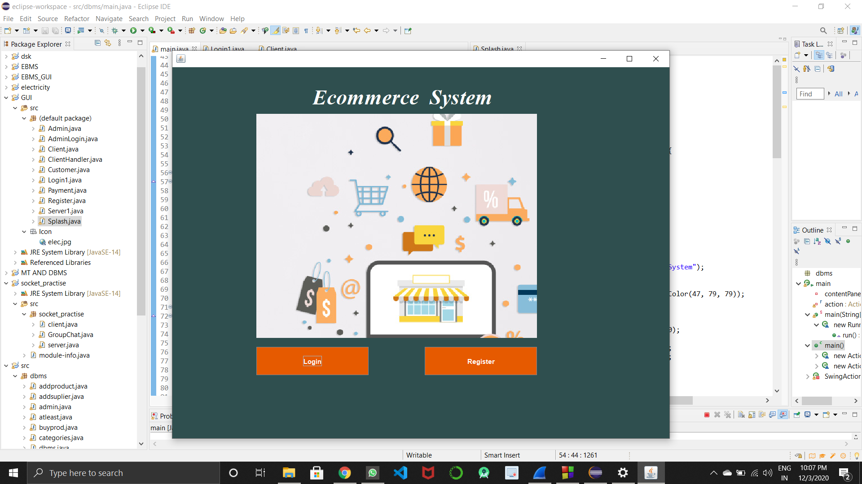
Screenshots
MAIN PAGE

Slide 10
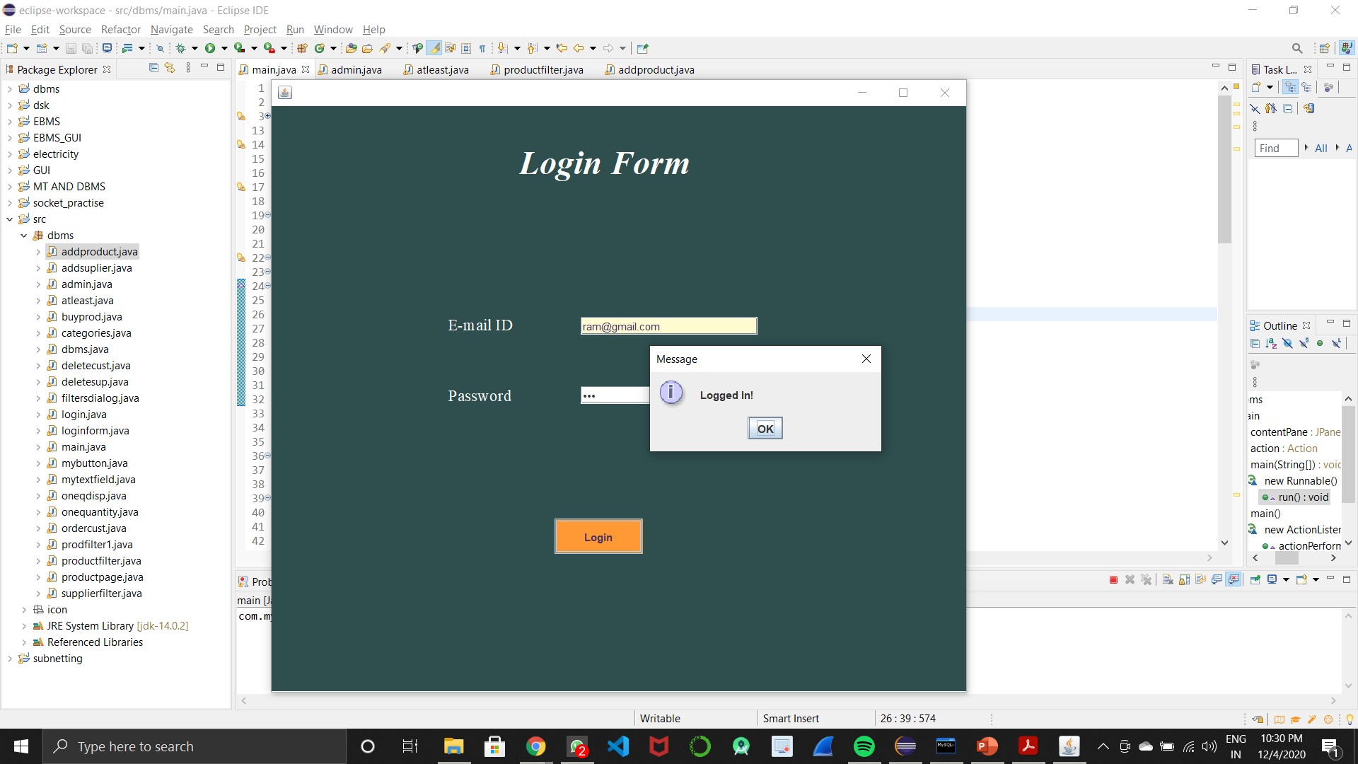
LOGIN PAGE

Slide 11
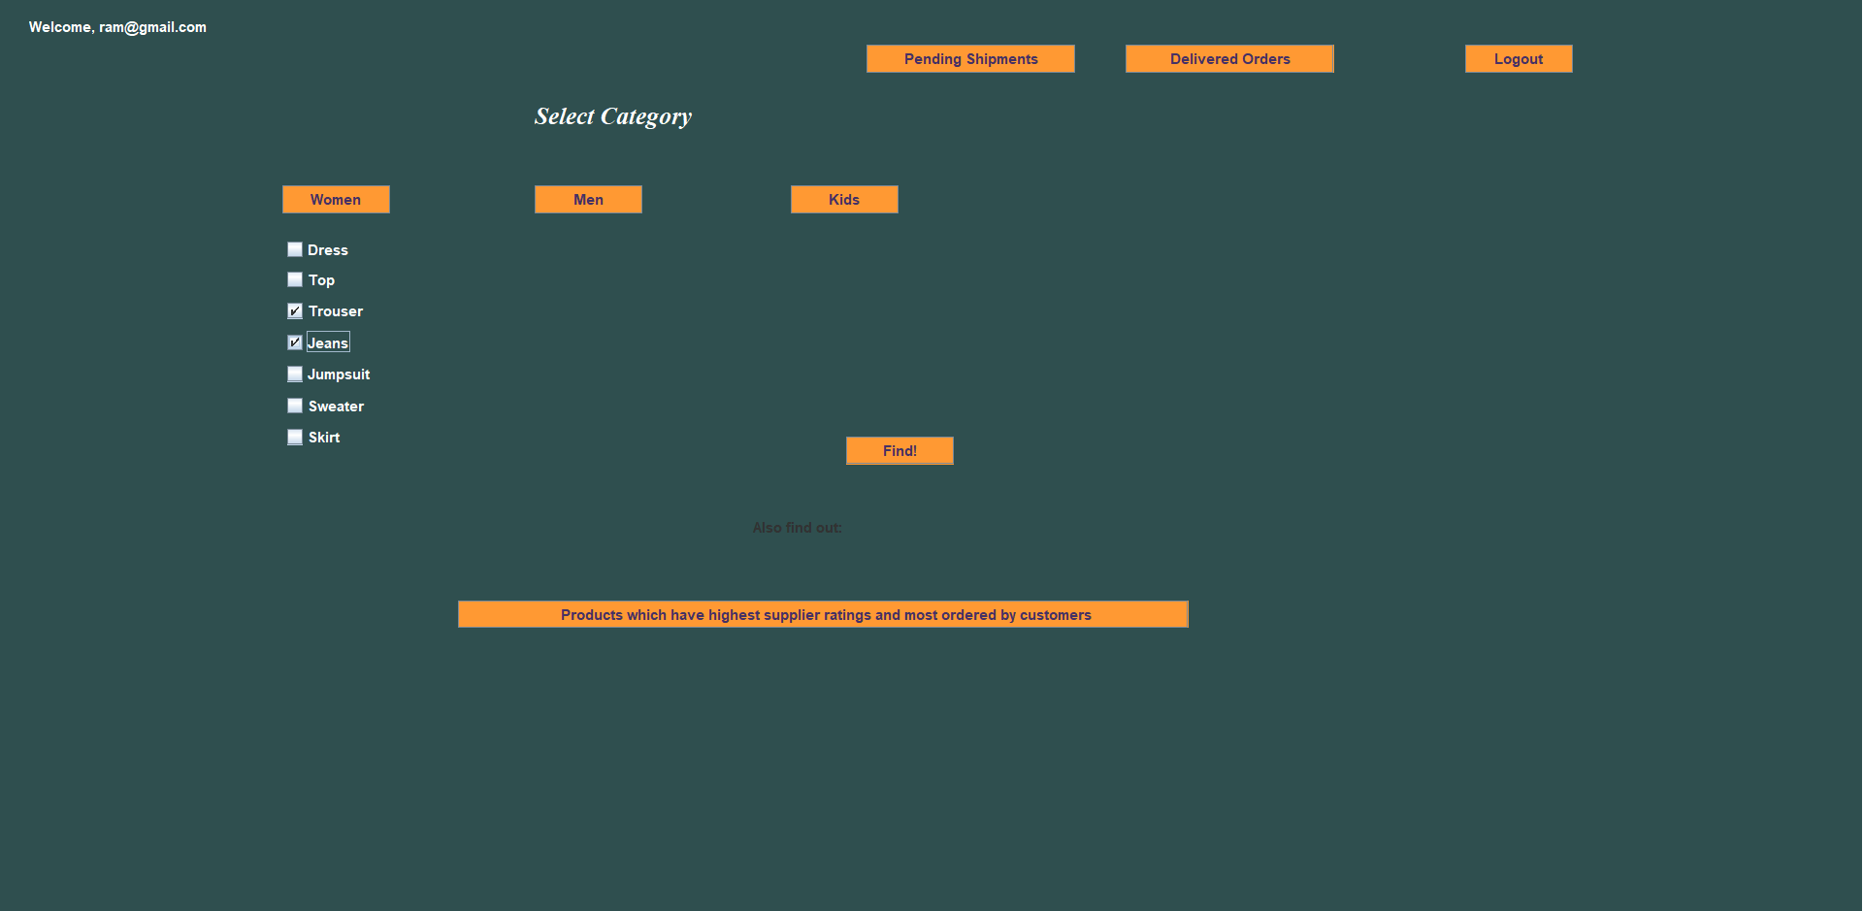
CUSTOMER PAGE

Slide 12
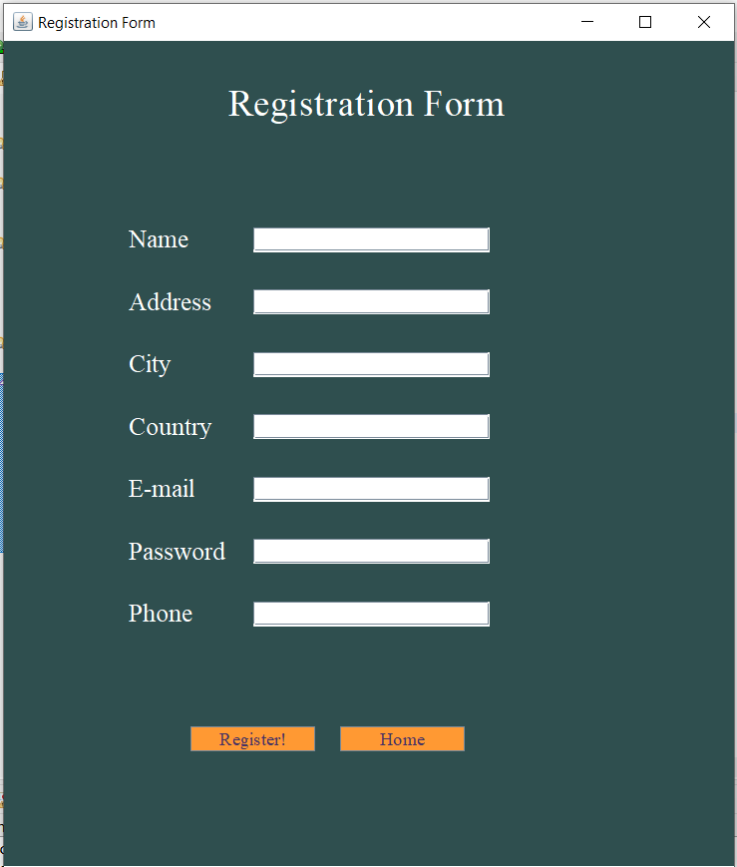
Registration form

Slide 13
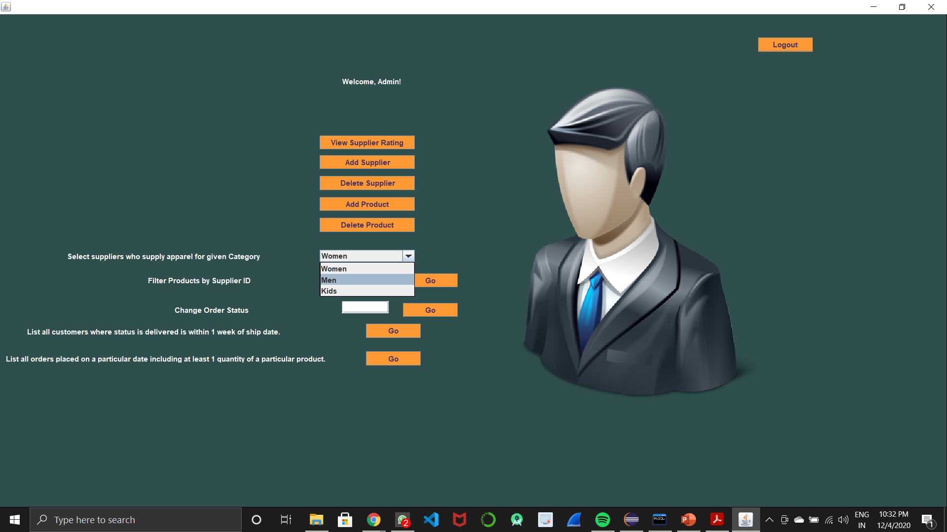
ADMIN PAGE

Slide 14
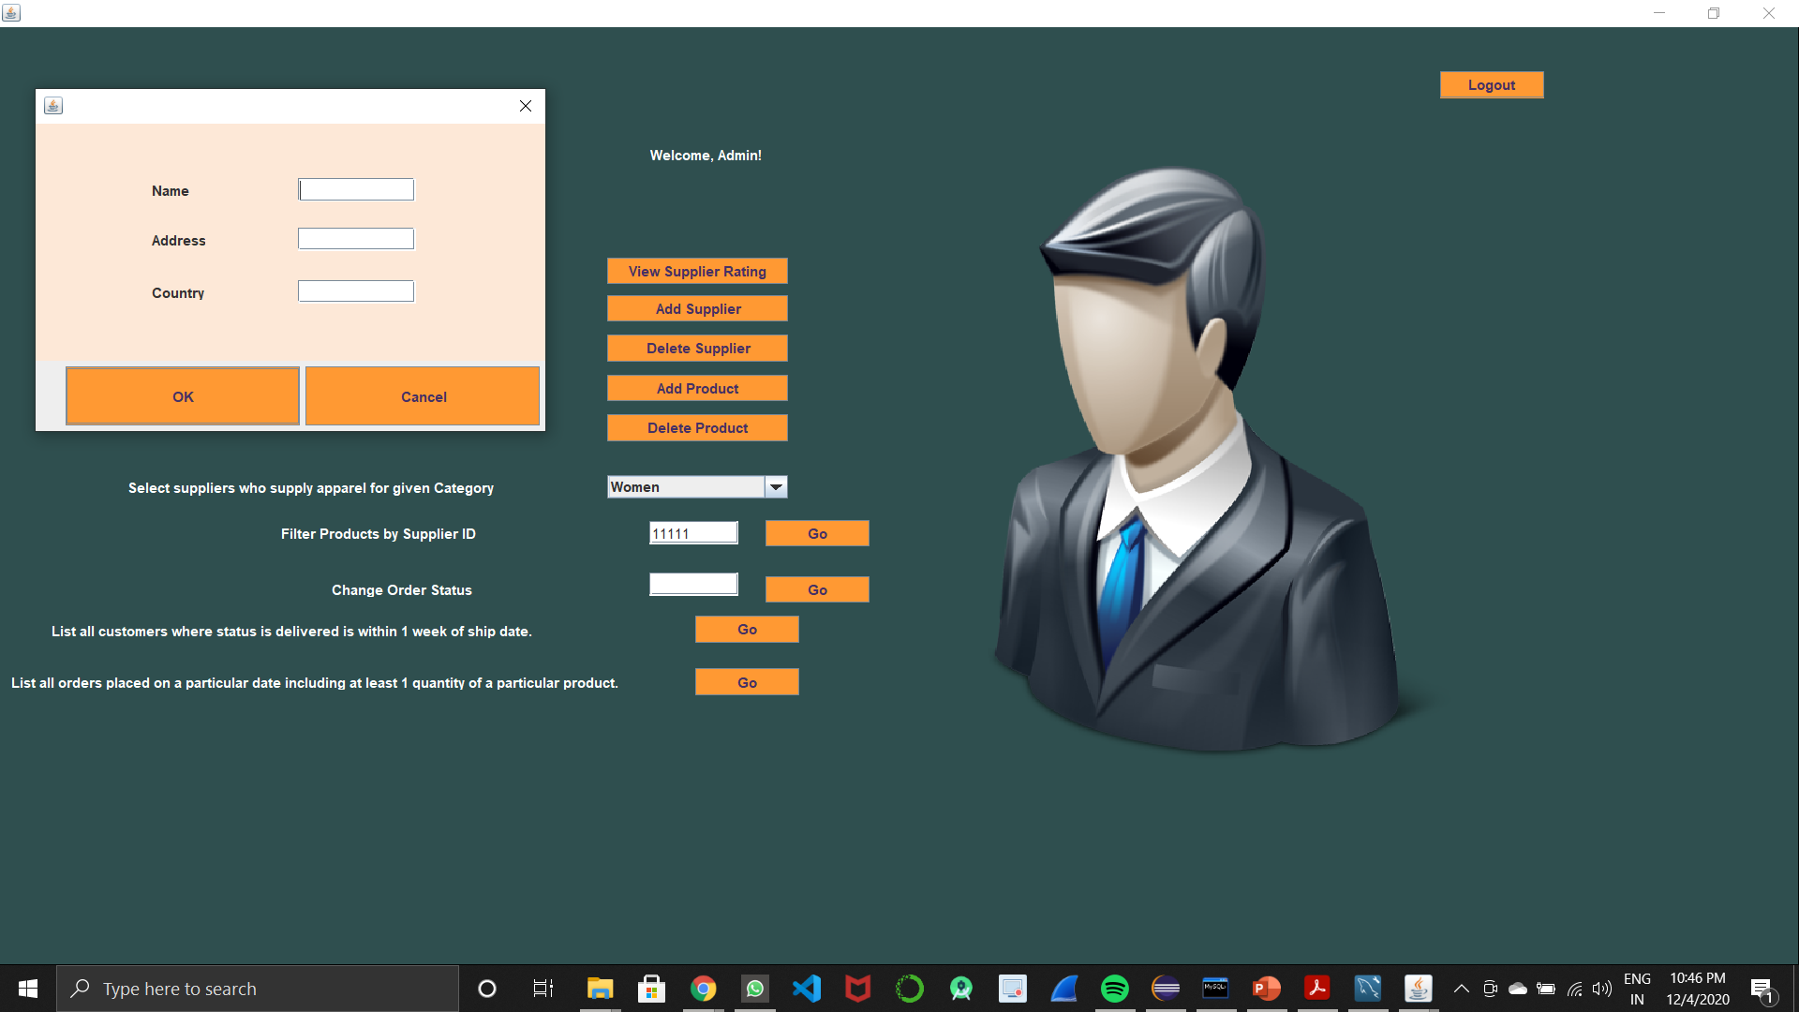
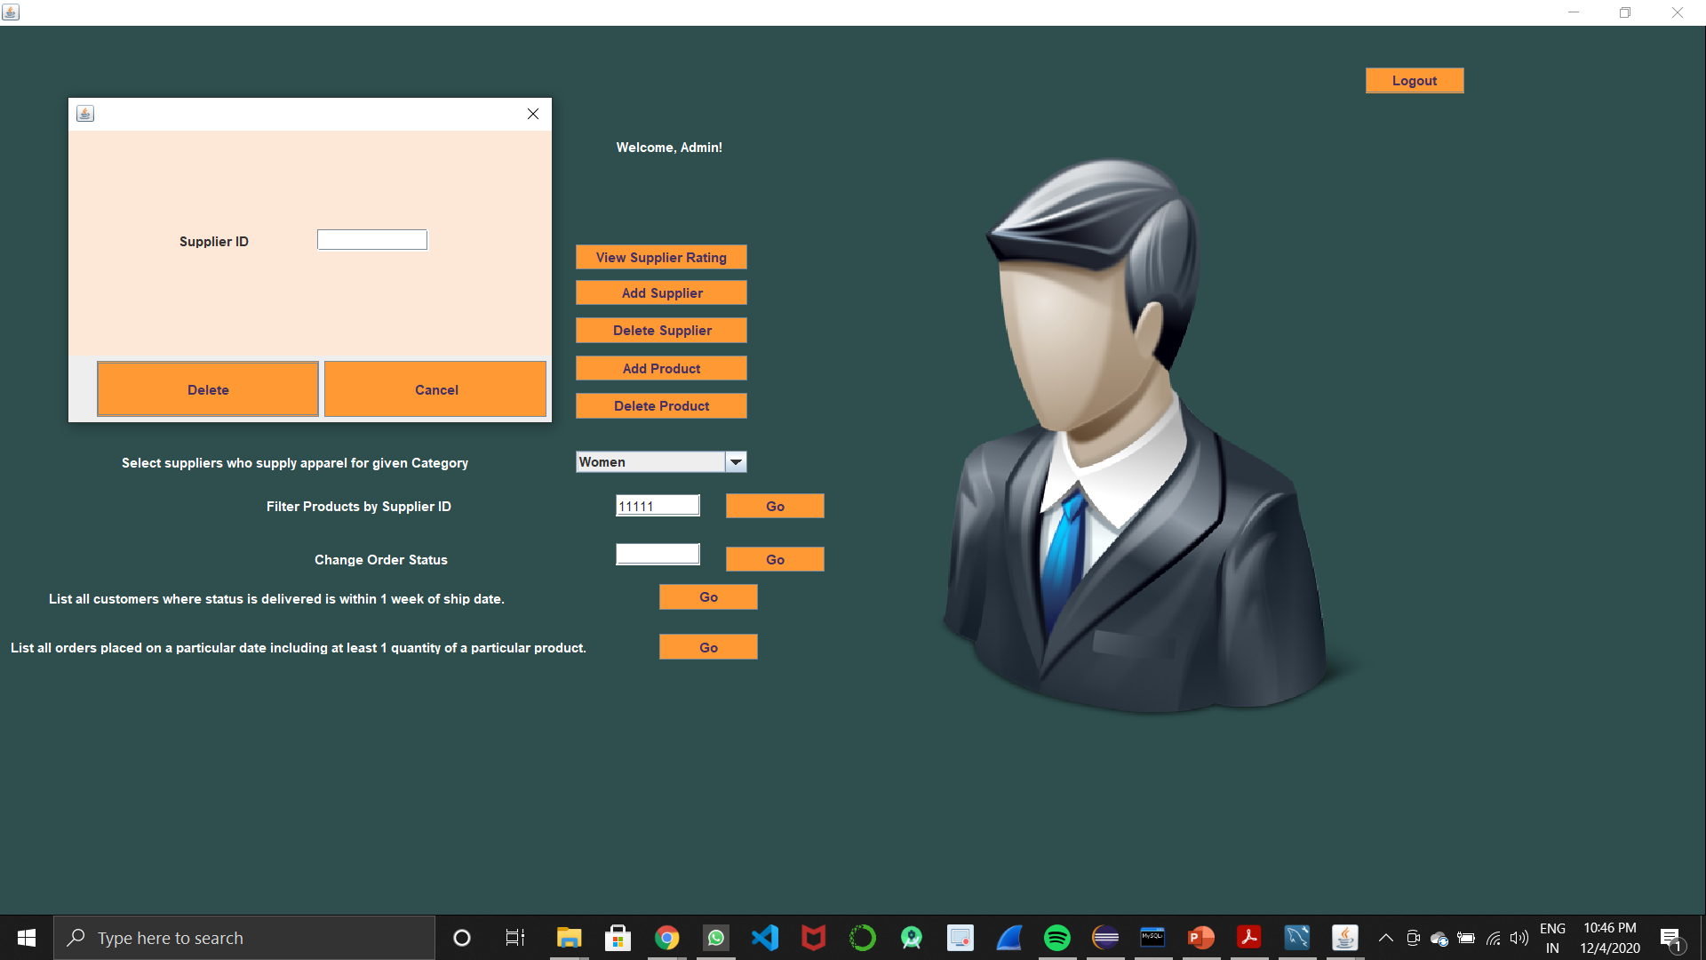
ADDING SUPPLIER DELETING SUPPLIER

Slide 15
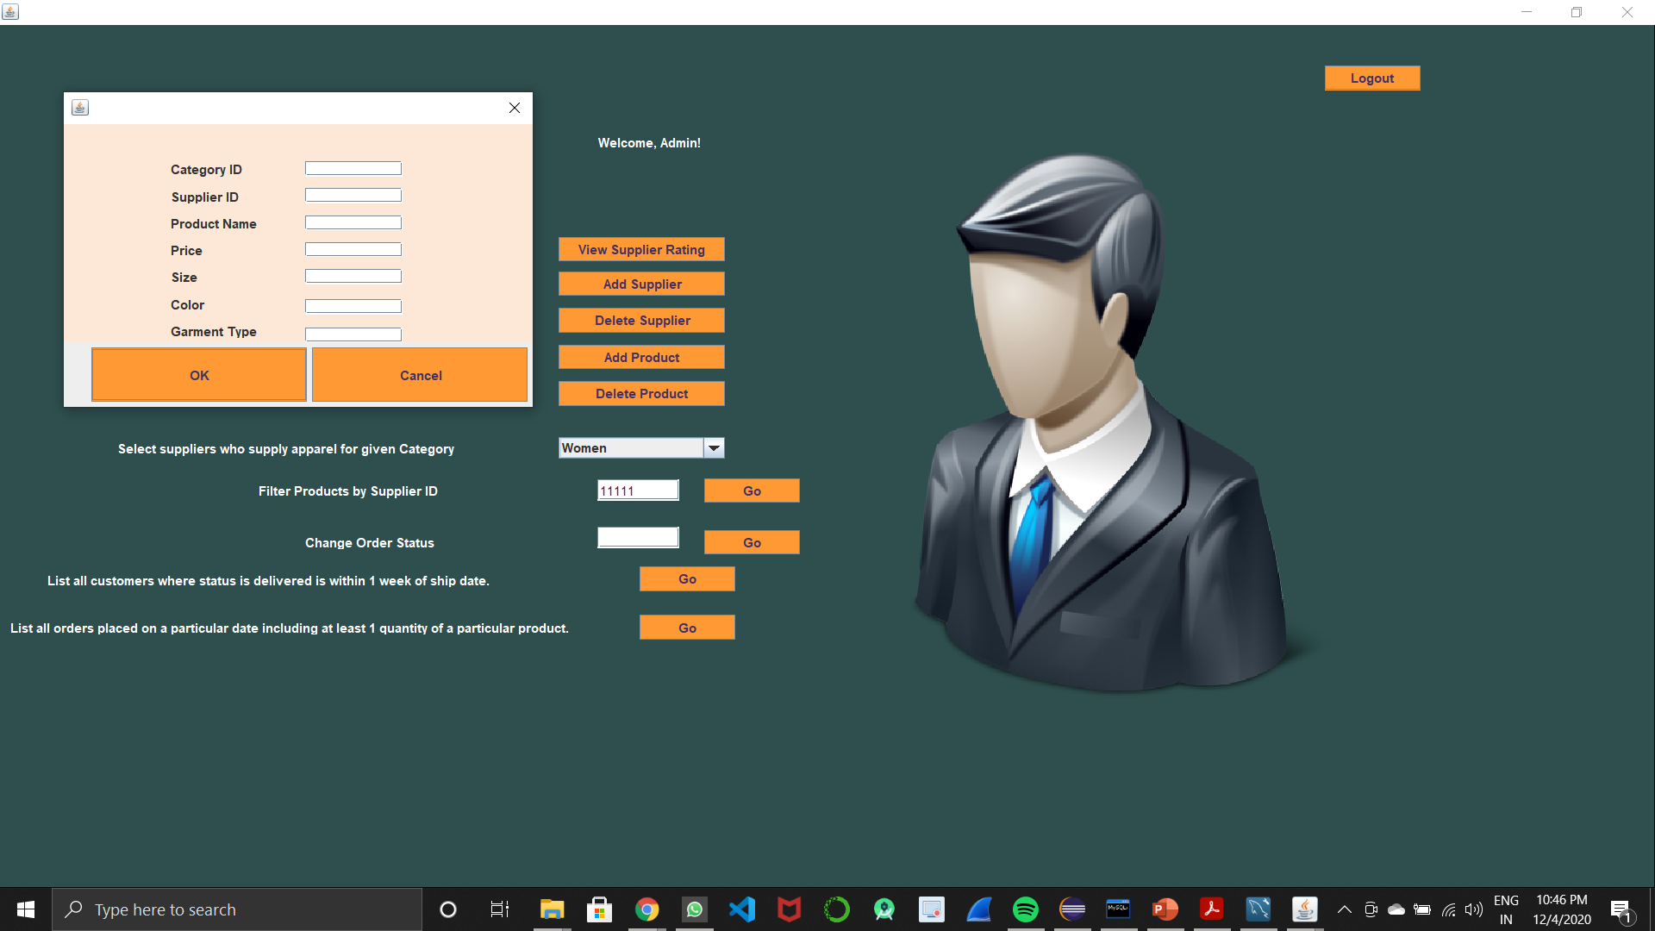

ADDING PRODUCTS DELETE PRODUCTS

Slide 16
Conclusion
We have successfully implemented the ecommerce system by using mysql,java swing.

Slide 17
Future scope
We will try to improve the web app by making it more scalable ,robust,secure.we will also try to make it more user friendly,we will also provide more functionalities to the web app

